Slide 1
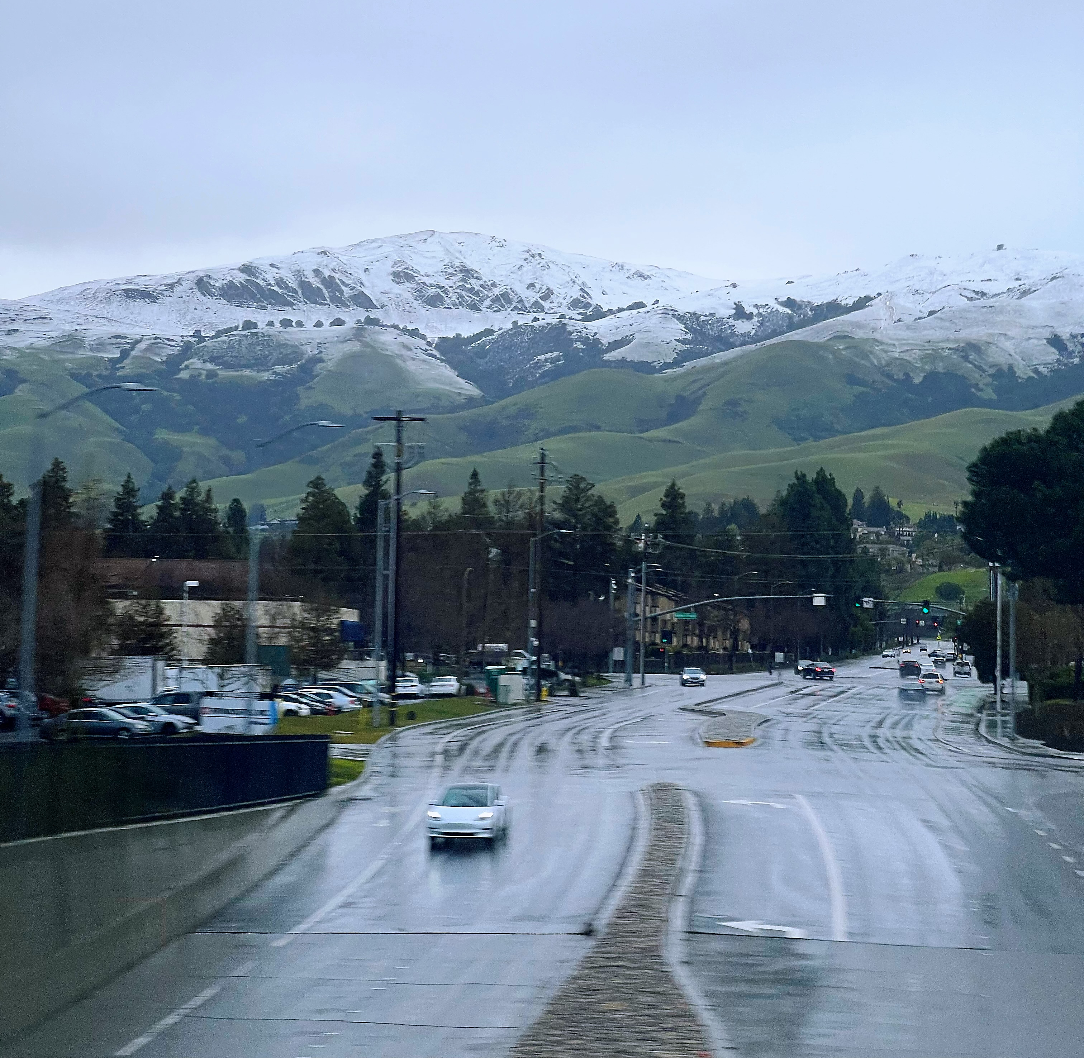

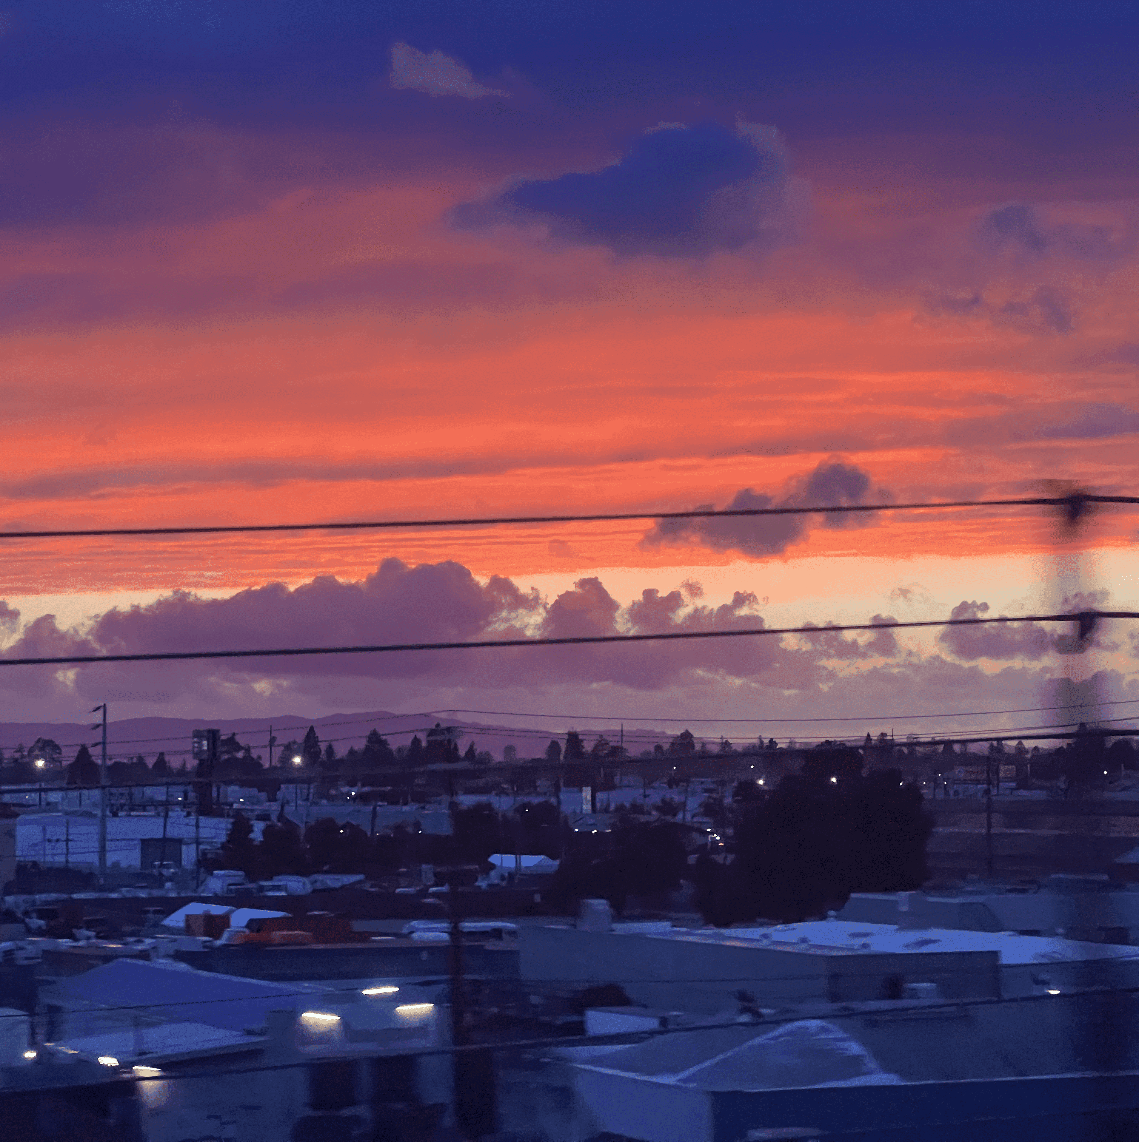

Xin Ai
9 months | Data Science Intern | CDFW
4 years | Data Analyst | Consulting
Master in Data Science | USF
Bachelor in Applied Mathematics | BIT
San Jose | San Francisco
Specialized in photography
Xinnnnn.ai@gmail.com
linkedin.com/in/xinai-x/

Slide 2
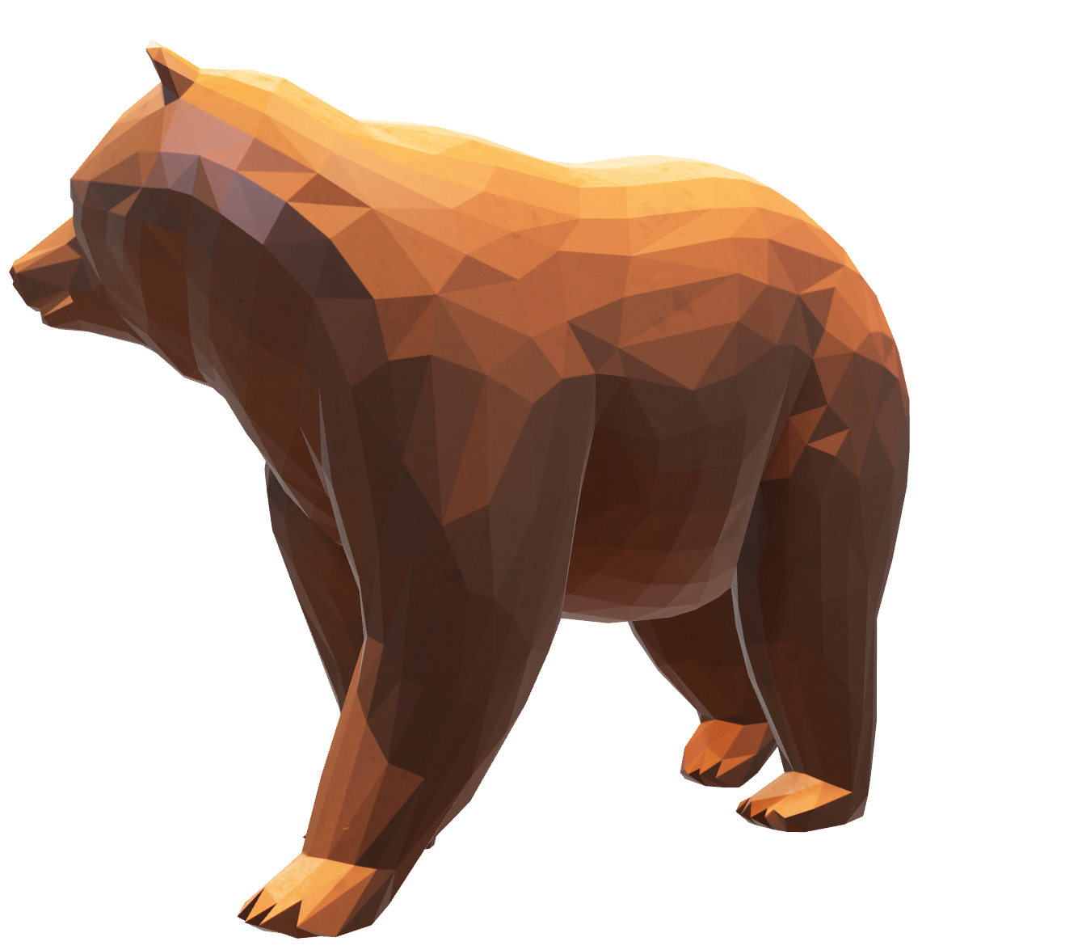
CDFW Blackbear 06/23/2023 Social Media NLP Project
1
Introduction
2
Milestones
3
Analyses
4
Discussions

Slide 3
INTRODUCTION
History Pain Points
Target of the practicum
Insufficient bear-encounter data points to analyze the frequency and geographic distribution over time.
Limited data hampers the ability to extract insights and update California Black bear’s management plan.
Gather a comprehensive dataset of social media posts relevant to bear-encounters.
Apply machine learning algorithms and NLP techniques to detect potential patterns and analyze public sentiments associated with bear-encounters.

Slide 4
Milestones
Pipeline
Feature Engineering
Labeling
Dashboard
Built a data pipeline with Twitter API
Conducted it in Airflow
Assigned coordinates by merging data sources
Unified county labels with Spark
Identified data imbalances
Utilized iterative semi-supervised learning
Built an interactive dashboard
Deployed it to AWS EC2
Database
Data Refinement
Modeling
Collected 450k tweets
Put the database to GCP Storage for data retrieve
POS Tagging
DBSCAN Clustering
Cut ~50% irrelevant tweets
ML: Ensemble model with classification algorithms
DL: Fine tune RoBERTa
Reached 0.91 F1 score

Slide 5
CHALLENGES | Identify bear-encounter tweets
Challenge
What I thought
What I did
"Bear” is a versatile word.
"Bear" is employed in fixed collocations.
"Bear" has diverse meanings beyond the animal species.
We can focus on collecting tweets where 'bear' is used as a noun.
We can utilize patterns or collocations of 'bear' to filter out irrelevant tweets.
POS Tagging
DBSCAN Clustering
Noun
Verb
Adjective
bear market
Big Bear Lake
Pet
Doll
People

Slide 6
CHALLENGES | Handle imbalanced data
Challenge
What I thought
What I did
The bear-encounter tweets, representing the minority class, have a class weight of less than 5%.
Prior to modeling, we can augment the number of minority class data.
During the modeling, we can: 1. simulate class weights of the whole data; 2. enhance the penalty for misclassifying minority instances.
Iterative semi-supervised learning: Spectral Clustering + AdaBoost
Data Augmentation + Modeling
Notes:
improve the model’s generalization for unlabeled data.

Slide 7
Overview
Data source: Twitter API
Posted Period: 2010/01/01 – 2022/12/31
Posted Area: California
Entries: 6017
Features: 11
Blackbear – Social Media NLP Project

Slide 8
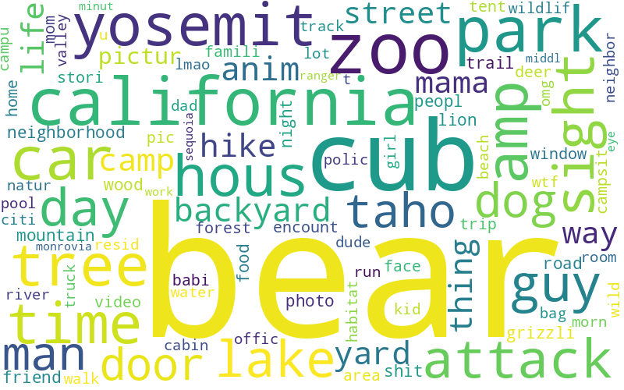
Mainly scenarios
Wild - Forest
Yosemite, Sequoia, hike, trail, tree, habitat, mountain, etc.
Wild - Places with water
Tahoe, lake, river, valley, etc.
Human Territory
zoo, house, backyard, camp, car, road, pool, campus, etc.
Top Nouns
Root-word Cloud
Blackbear – Social Media NLP Project

Slide 9
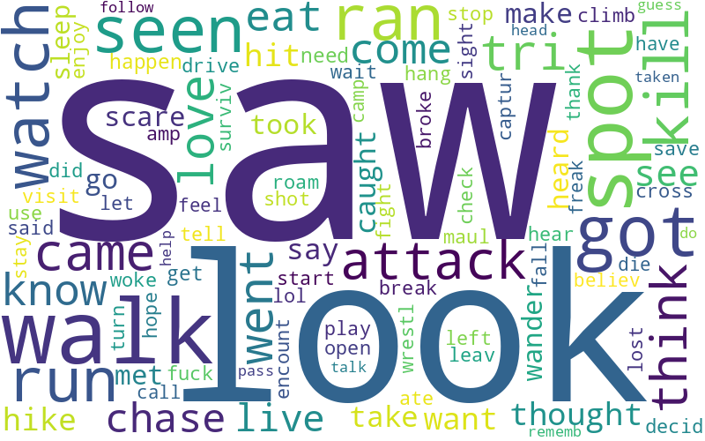
Mainly scenarios
How to meet
saw, look, watch, seen, spot, sight, heard, encounter, etc.
What bears did
attack, chase, walk, play, cross, wander, hit, visit, etc.
What people did
ran, drive, leave, pass, wait, caught, fight, survive, kill, etc.
Top Verbs
Root-word Cloud
Blackbear – Social Media NLP Project

Slide 10
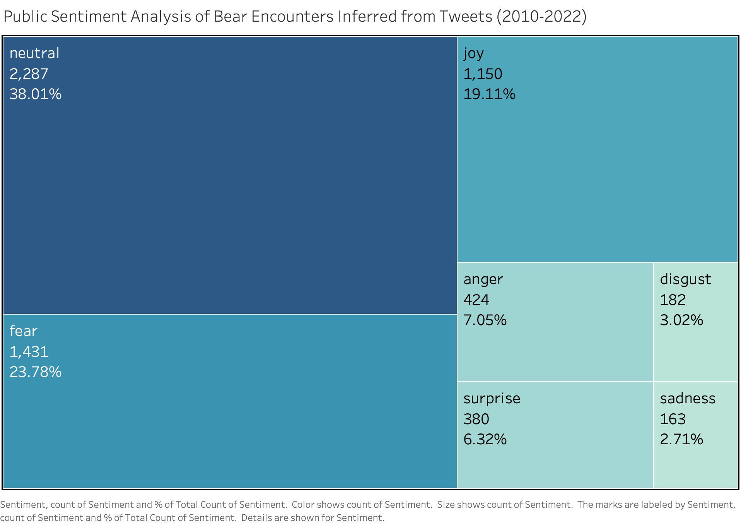
Aside from the 38% of people who are indifferent, the predominant responses to bear encounters are a mixture of fear (23.78%) and joy (19.11%).
Public Sentiments on Bear-encounters
Blackbear – Social Media NLP Project

Slide 11
Summer is the season with the highest number of bear encounters, and it's also the time when fear is most pronounced, often over-shadowing the sense of joy.
fear
joy
Frequency and Sentiments of Bear-encounters
Blackbear – Social Media NLP Project

Slide 12
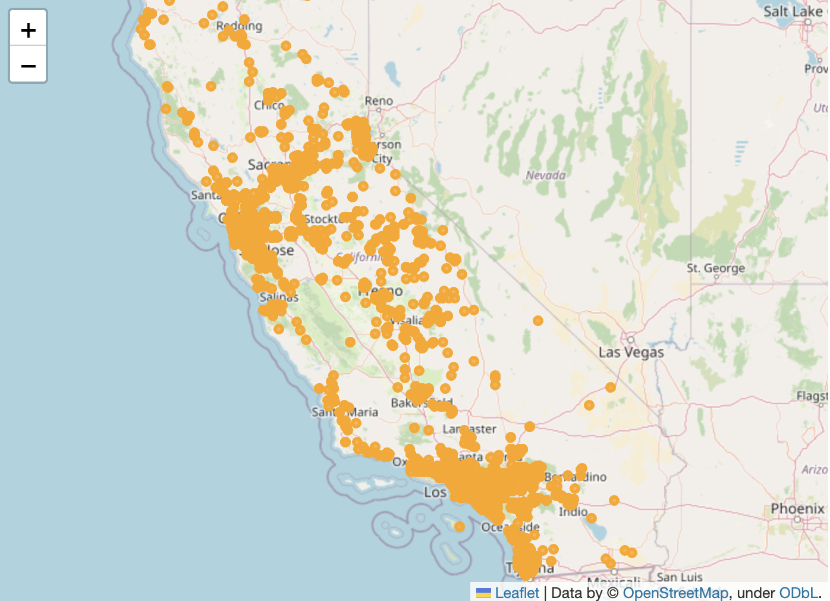
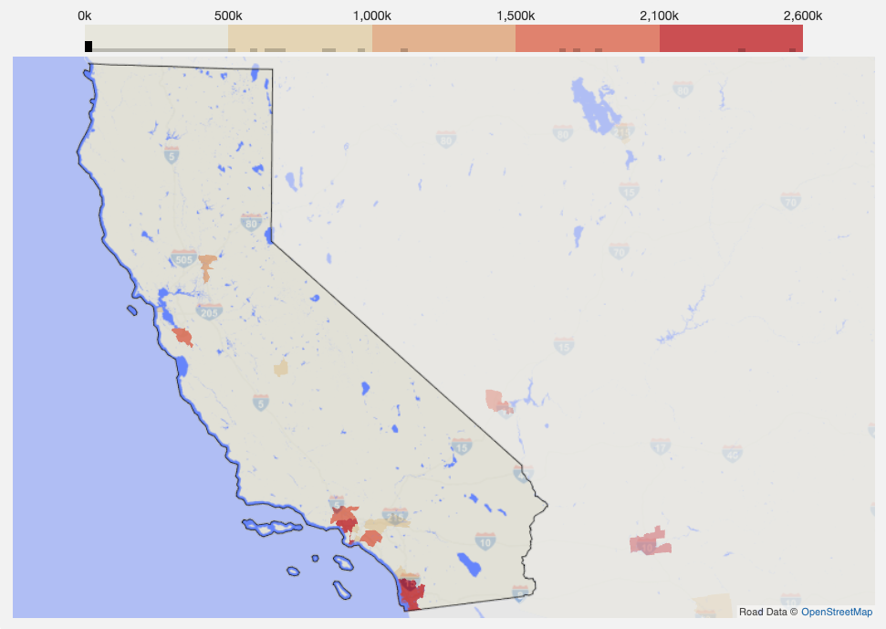
Posting tweets about bear encounters is not a real-time behavior, but often occurs with a delay of several hours to days. As a result, such tweets were concentrated in areas with dense populations or popular outdoor destinations.
Geographic Distribution of Bear Encounter Tweets
Population by County Subdivision in California
SF +
Bay Area
Yosemite
LA + SD
Blackbear – Social Media NLP Project

Slide 13
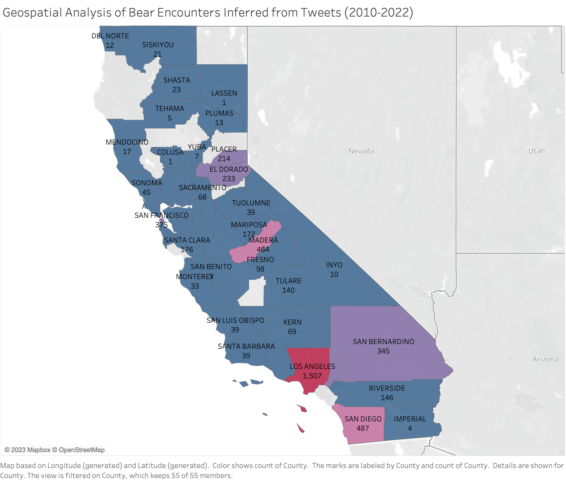
Areas with the most bear encounter tweets
(Metro Area & Outdoor destinations)
Los Angeles | 1507
San Diego | 487
San Francisco | 375
--------------------------
Madera (Yosemite) | 464
Placer + EL Dorado (Tahoe) | 447
San Bernardino (Big Bear Area) | 345
Tahoe
447
SF
375
Yosemite
464
Big Bear Area
345
Geo Distribution of Bear-encounter Tweets
LA
1507
SD
487

Slide 14
According to ANOVA, environmental factors (temperature, precipitation, etc.) significantly impact bear encounters in five of the top six areas. Higher temperatures and lower precipitation tend to promote more bear encounters.
Los Angeles - 1507
Madera (Yosemite) - 464
Bear encounters vs. Avg temperature
p value: 0.003 | Adj.R2: 0.565 | coef: 3.540
Bear encounters vs. Precipitation
p value: 0.001 | Adj.R2: 0.621 | coef: -20.849
Bear encounters vs. Avg temperature
p value: 0.000 | Adj.R2: 0.812 | coef: 1.982
Bear encounters vs. Precipitation
p value: 0.001 | Adj.R2: 0.674 | coef: -32.487
San Diego - 487
Placer+EL Dorado (Tahoe) - 447
Bear encounters vs. Avg temperature
p value: 0.080 | Adj.R2: 0.202 | coef: 0.951
Bear encounters vs. Precipitation
p value: 0.140 | Adj.R2: 0.125 | coef: -6.383
Bear encounters vs. Avg temperature
p value: 0.000 | Adj.R2: 0.812 | coef: 1.982
Bear encounters vs. Precipitation
p value: 0.001 | Adj.R2: 0.674 | coef: -32.487
San Diego Zoo is a significant source of bear encounters.
San Francisco - 375
San Bernardino (Big Bear) - 345
Bear encounters vs. Avg temperature
p value: 0.158 | Adj.R2: 0.108 | coef: 1.419
Bear encounters vs. Precipitation
p value: 0.046 | Adj.R2: 0.276 | coef: -4.233
Bear encounters vs. Avg temperature
p value: 0.026 | Adj.R2: 0.346 | coef: 0.518
Bear encounters vs. Precipitation
p value: 0.322 | Adj.R2: 0.008 | coef: -1.768
Notes:
Bear encounters in San Diego appear less influenced by environmental factors due to the presence of the renowned San Diego Zoo, a significant source of bear encounters unaffected by environmental changes or seasons.

Slide 15
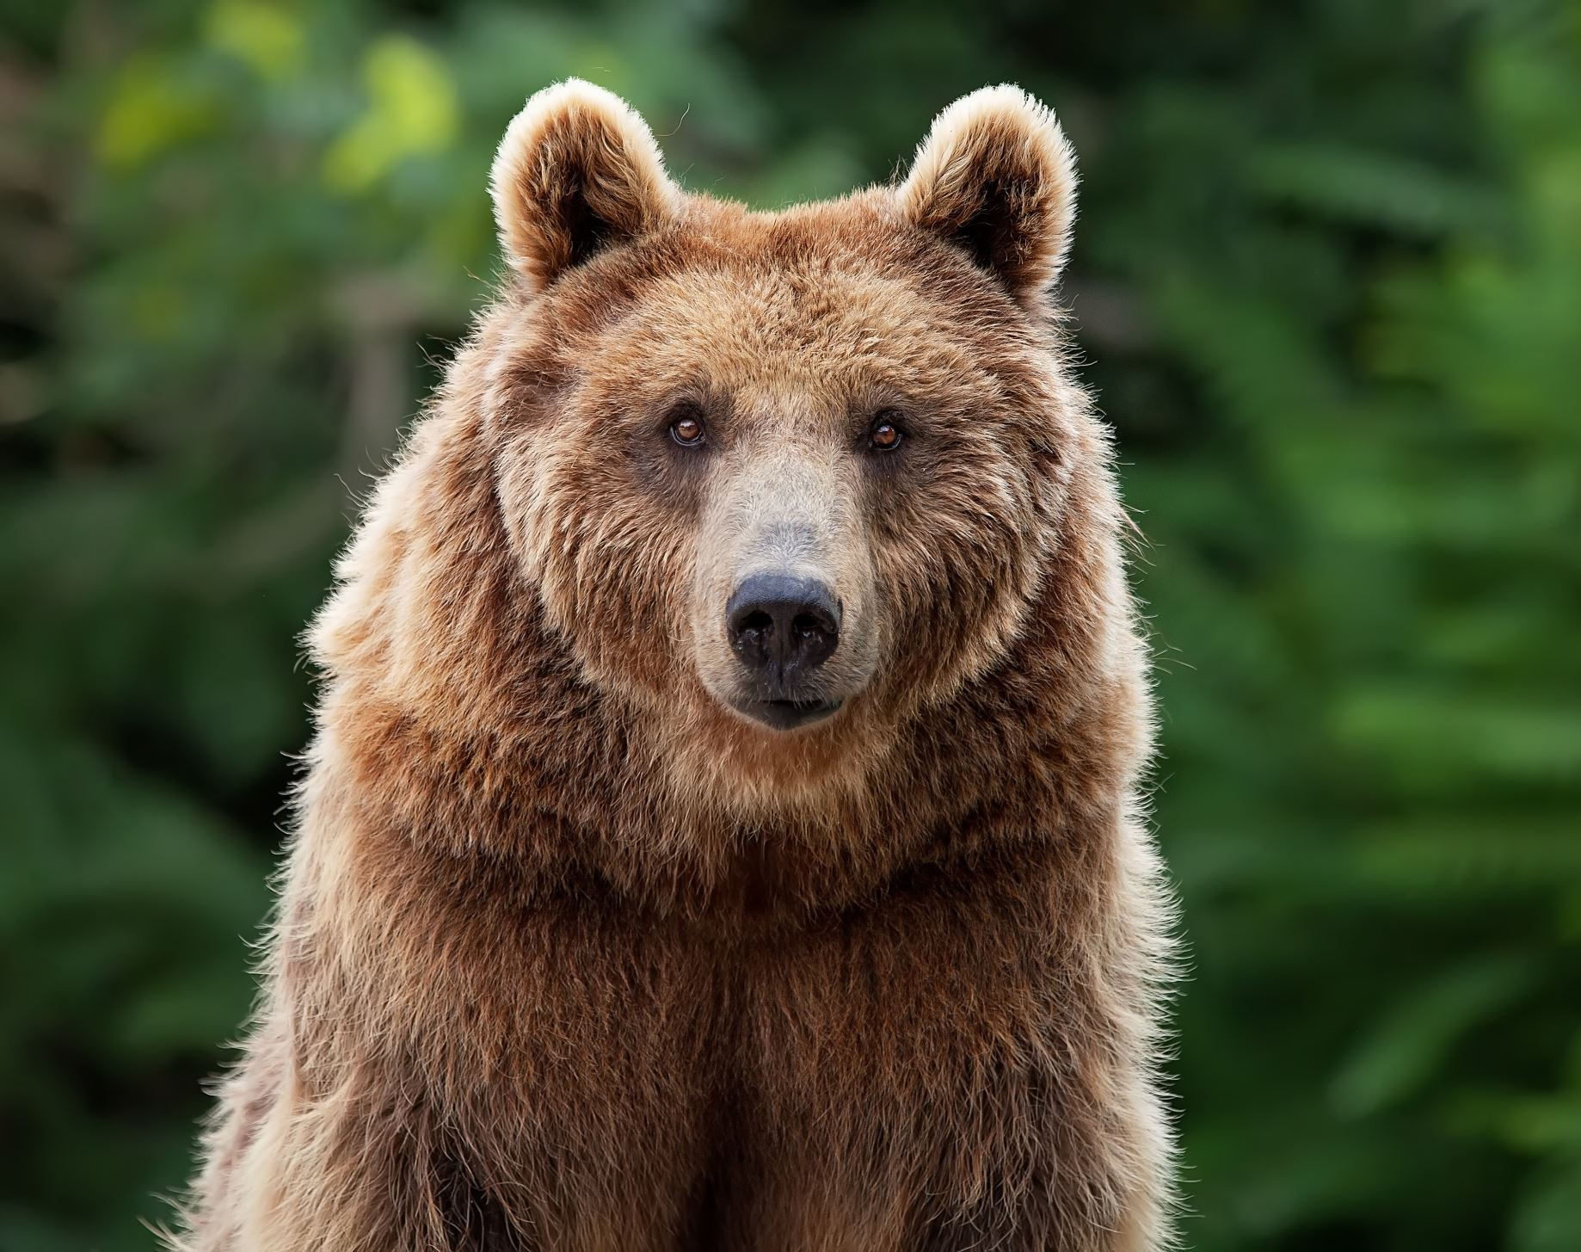
Public sentiments toward bear encounters shift throughout the year. In metropolitan areas, the summer season tends to trigger heightened fear and anger towards such interactions. Residents typically seek tranquility and routine in their daily lives. Unexpected encounters with potentially threatening wildlife such as bears can dramatically disrupt this sense of normalcy, resulting in intense reactions.
Conversely, people visiting popular outdoor destinations often exhibit more intense reactions in summer, but these emotions encompass both fear and joy. These contrasting emotions can be attributed to the mindset of outdoor enthusiasts. Engaging in activities like hiking, camping, fishing, and skiing, these individuals generally anticipate and prepare for potential wildlife encounters. These experiences offer opportunities to immerse themselves in the wilderness, fostering a deeper connection with nature, although sometimes daunting, can also elicit feelings of exhilaration and joy.

Slide 16
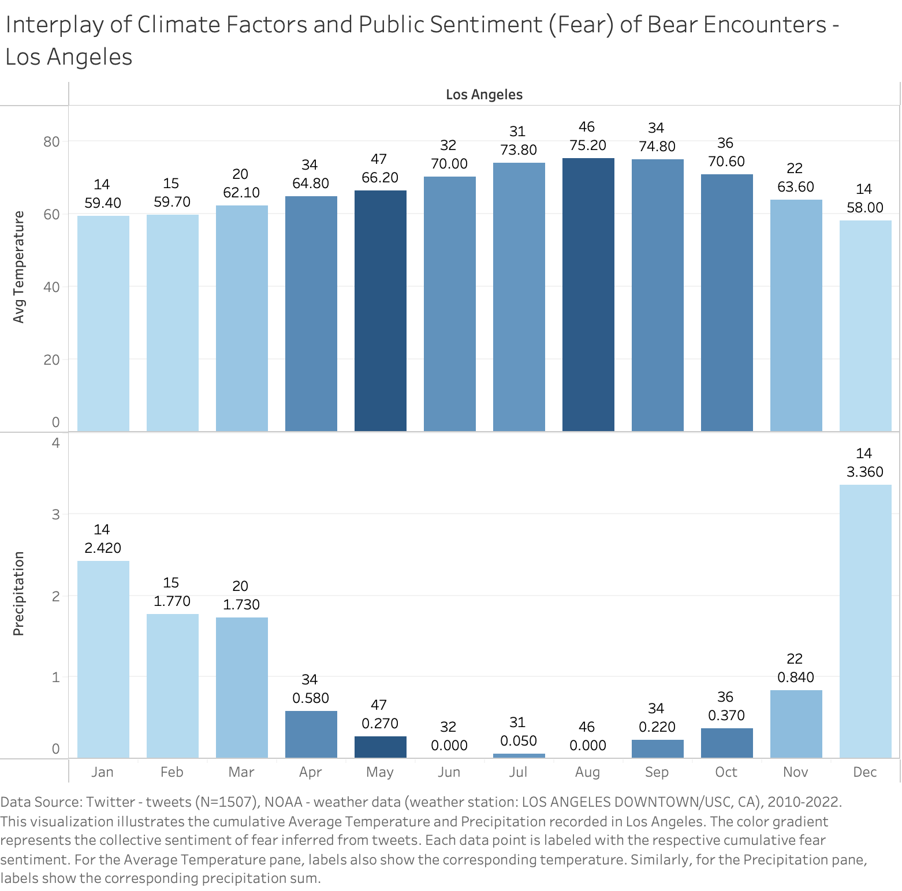
Los Angeles
Sentiments & Months One-way ANOVA:
F value: 66.579 | p value: 0.000
Correlation between sentiment (N>30) and Avg Temp:
fear: 0.773 | anger: 0.652 | neutral: 0.610 | sadness: 0.542 | joy: 0.337 | surprise: 0.200 | disgust: -0.060
Correlation between sentiment(N>30) and Precipitation:
fear: -0.837 | neutral: -0.707 | anger: -0.655 | sadness: -0.460 | surprise: -0.340 | disgust: 0.083 | joy: -0.020

Slide 17
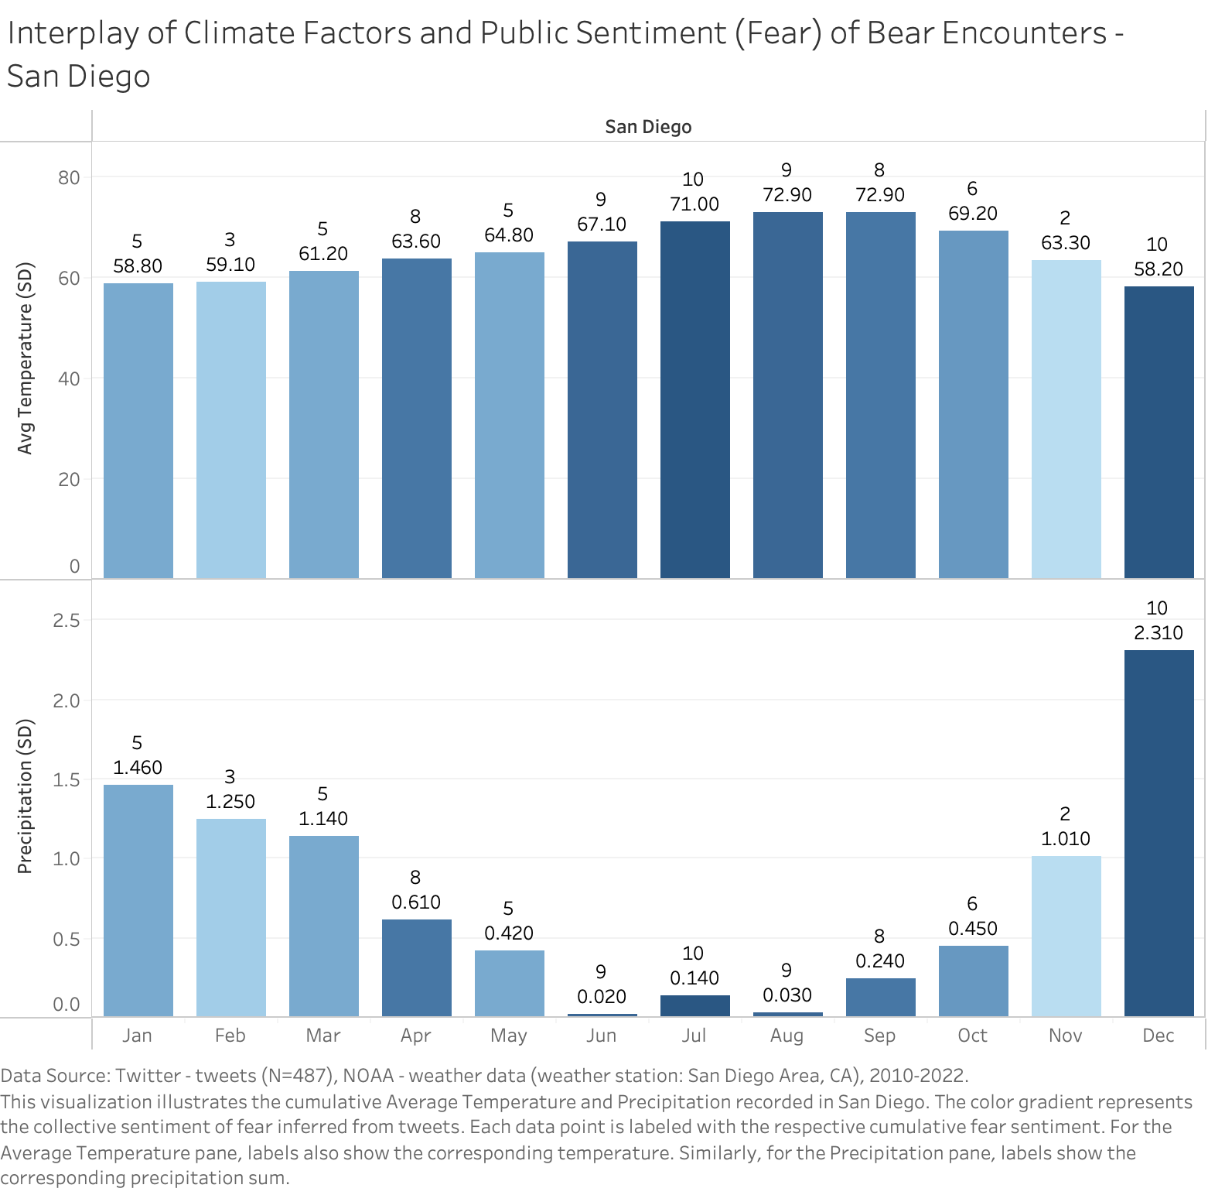
San Diego
Sentiments & Months One-way ANOVA:
F value: 70.477 | p value: 0.000
Correlation between sentiment (N>30) and Avg Temp:
fear: 0.454 | neutral: 0.406 | joy: 0.284
Correlation between sentiment(N>30) and Precipitation:
neutral: -0.338 | fear: -0.252| joy: -0.109
The San Diego Zoo stands as a major source of bear encounters, particularly prominent in December. This notable volume during this month aligns with vacations such as the Christmas holiday, New Year's Eve, and school winter breaks.

Slide 18
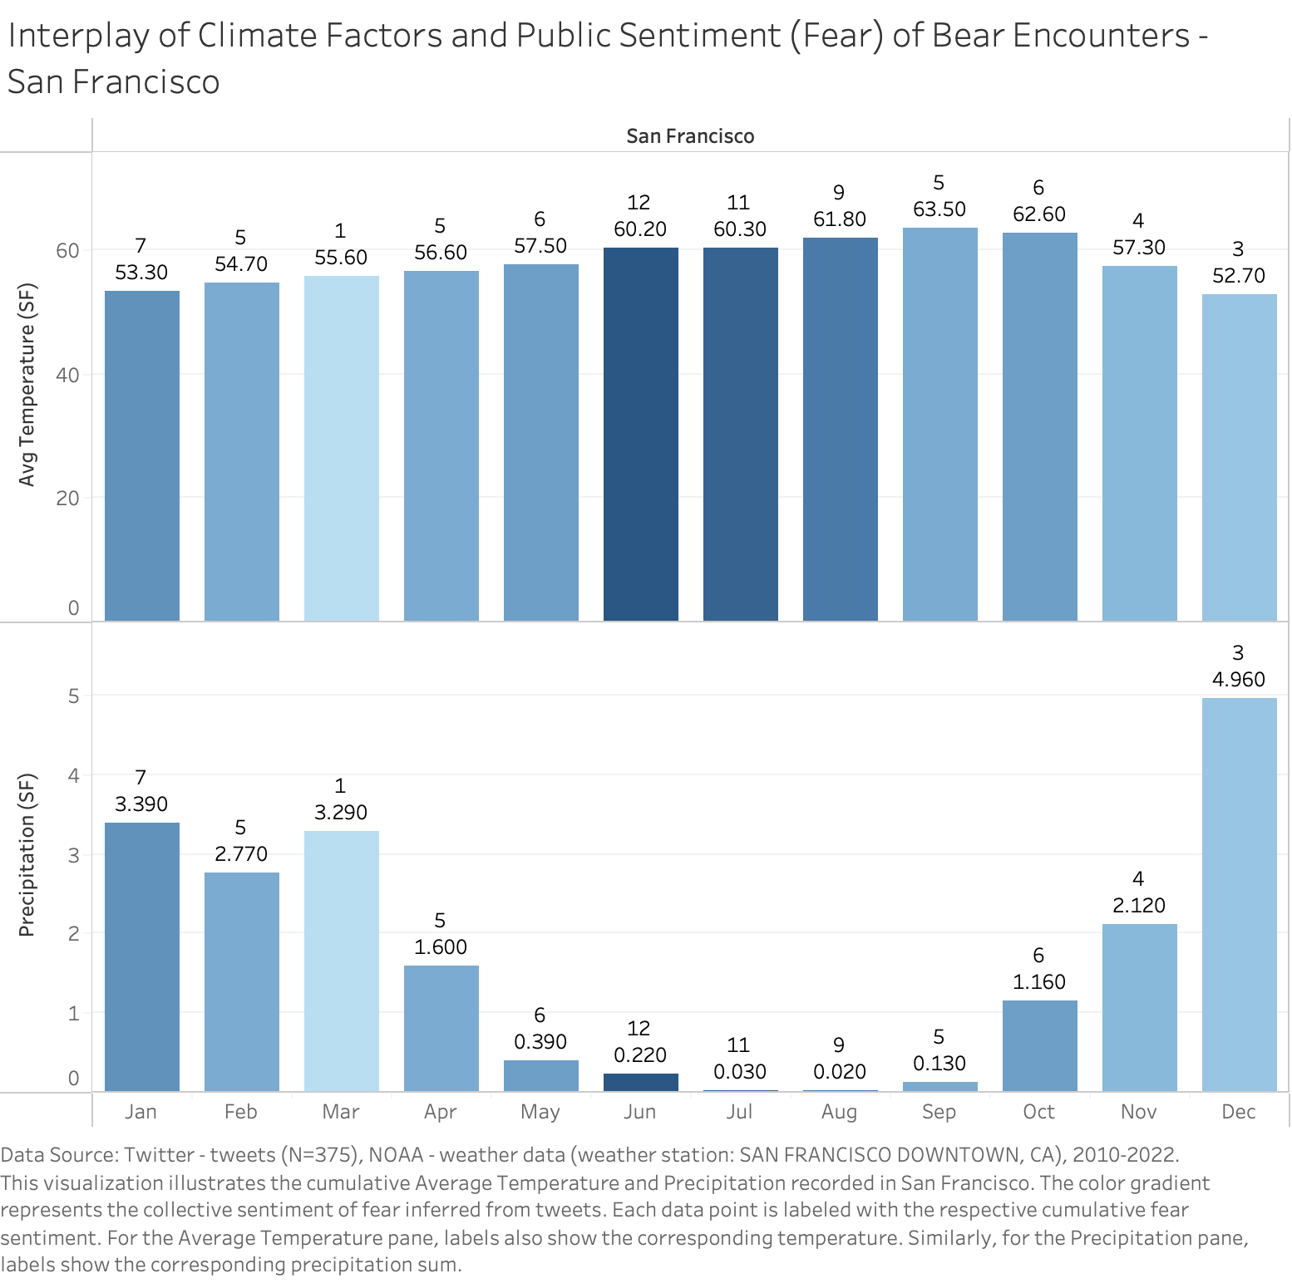
San Francisco
Sentiments & Months One-way ANOVA:
F value: 23.024 | p value: 0.000
Correlation between sentiment (N>30) and Avg Temp:
fear: 0.470 | neutral: 0.396 | joy: 0.161
Correlation between sentiment(N>30) and Precipitation:
fear: -0.669 | neutral: -0.505 | joy: -0.164

Slide 19
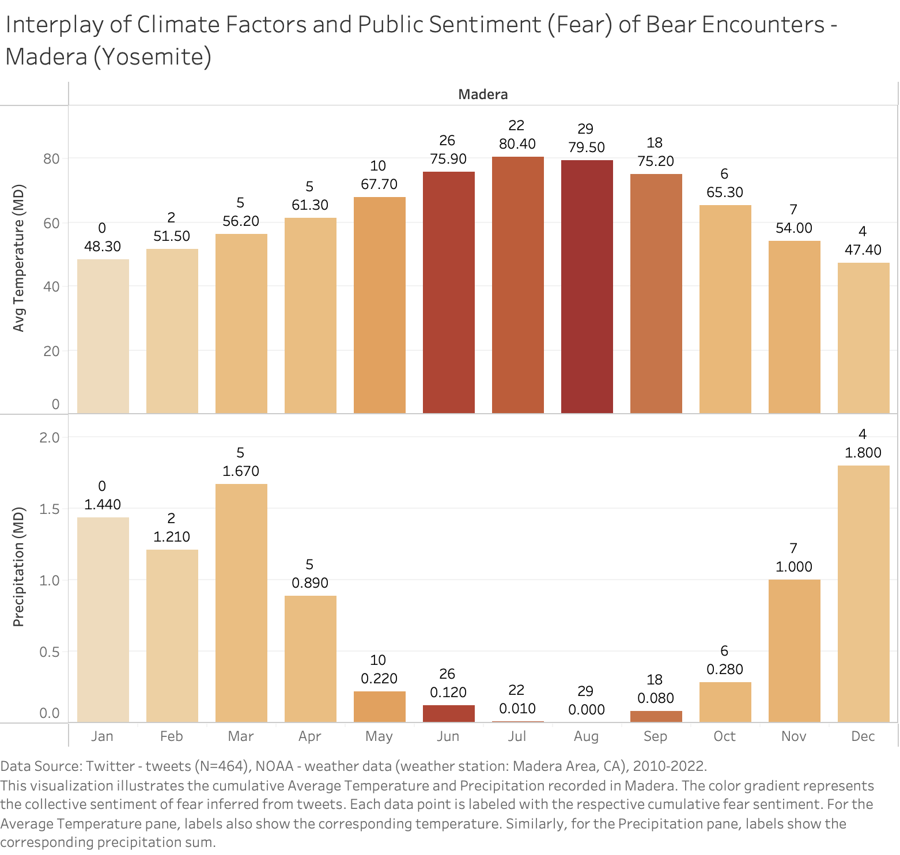
Yosemite
Sentiments & Months One-way ANOVA:
F value: 10.230 | p value: 0.000
Correlation between sentiment (N>30) and Avg Temp:
fear: 0.910 | anger: 0.866 | joy: 0.859 | neutral: 0.709
Correlation between sentiment(N>30) and Precipitation:
anger: -0.801 | fear: -0.792 | joy: -0.752 | neutral: -0.729

Slide 20
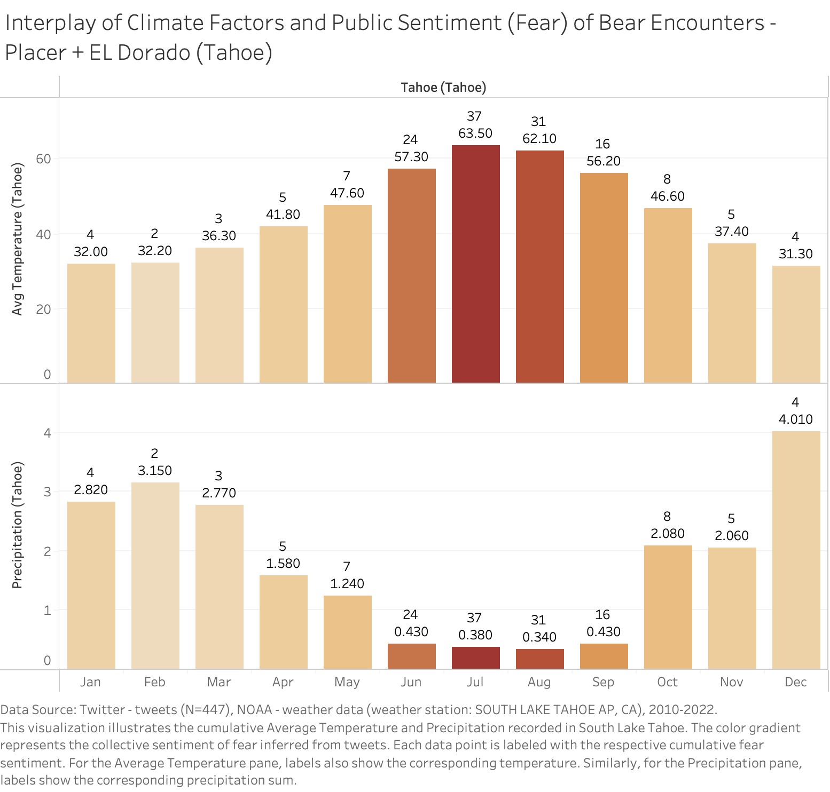
Tahoe
Sentiments & Months One-way ANOVA:
F value: 8.112 | p value: 0.000
Correlation between sentiment (N>30) and Avg Temp:
fear: 0.916 | joy: 0.911 | neutral: 0.854
Correlation between sentiment(N>30) and Precipitation:
fear: -0.799 | joy: -0.770| neutral: -0.725

Slide 21
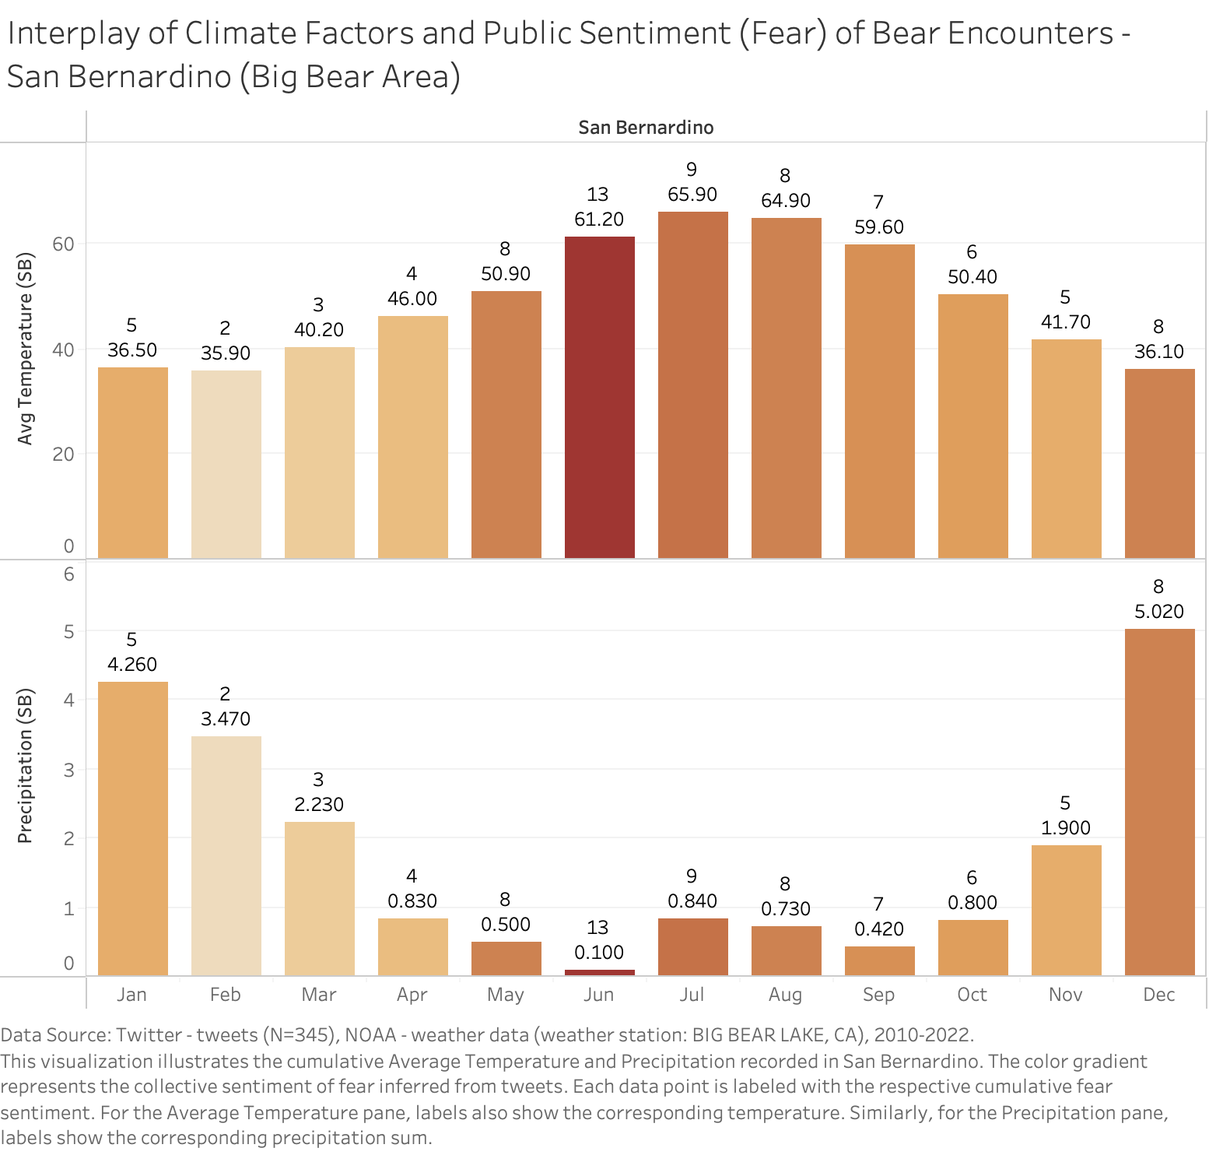
Big Bear AREA
Sentiments & Months One-way ANOVA:
F value: 26.736 | p value: 0.000
Correlation between sentiment (N>30) and Avg Temp:
fear: 0.690 | joy: 0.543 | neutral: 0.348 | anger: -0.312
Correlation between sentiment(N>30) and Precipitation:
joy: -0.576 | anger: 0.558 | fear: -0.419 | neutral: -0.027

Slide 22
limitations
The geographic location of tweets does not immediately represent the specific location of bear sightings.
Tweets cannot filter out non-California bear encounters, as many of them are people's retrospective accounts.
The data points displayed in tweets are more than actual bear encounters, due to multiple people reporting the same bear encounter or discussing news events.
In some contexts, it is impossible to completely distinguish between a real bear and bear plush toys, certain individuals, or bears in game scenarios like #TheRevenant (game).

Slide 23
Further Directions
Time Series Analysis: Conduct predictive analysis on potential bear encounter frequencies and locations to inform preventive measures, aiding in the reduction of public panic and economic fallout.
Exploratory Analysis: Expand the scope to encompass other potential factors influencing bear encounters, such as incidences related to food attraction when humans are outdoors.
Comparative Analysis: Compare the characteristics of bear encounters with those of other wildlife encounters, derive unique insights and create comprehensive strategies for managing human-wildlife interactions.

Slide 24
Deliverables
Dashboard
Database
Tech blog
Report (In progress)

Slide 25
Thank you
Xin Ai
linkedin.com/in/xinai-x
xinnnnn.ai@gmail.com
669-260-3982

